Slide 1
Forgeries: Civil & Criminal Issues
Amanda Gray
Mishcon de Reya
FLA SEMINAR

Slide 2

Forgeries: Civil & criminal issues
'I paint pastiches - not forgeries'

Slide 3
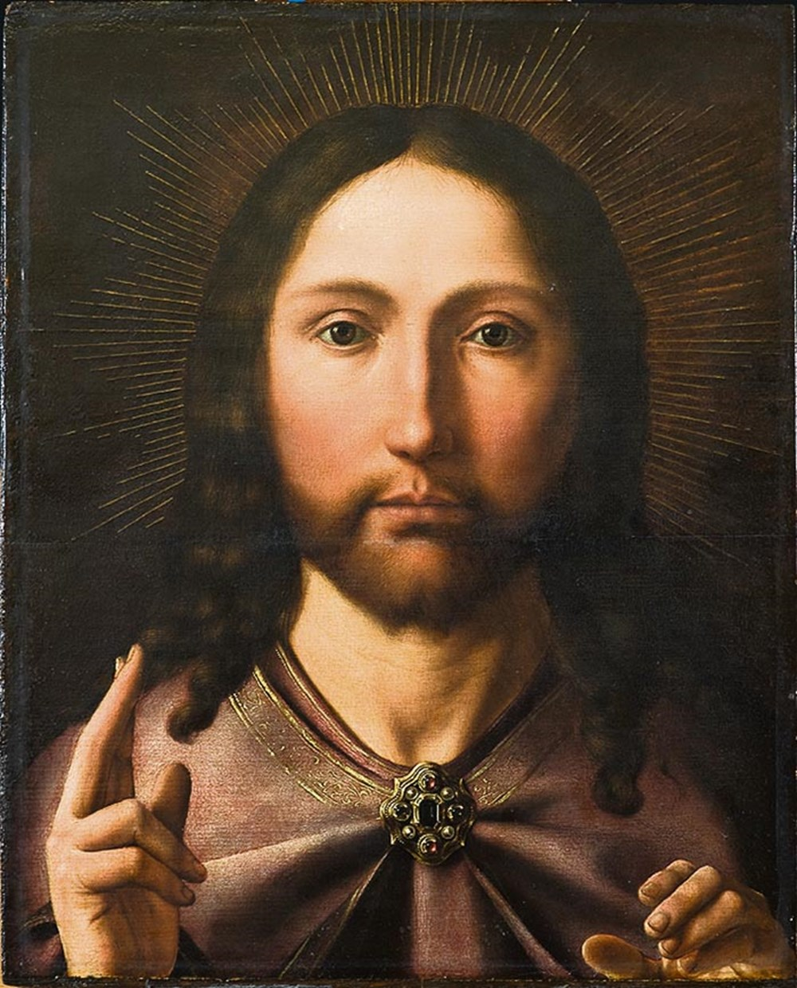
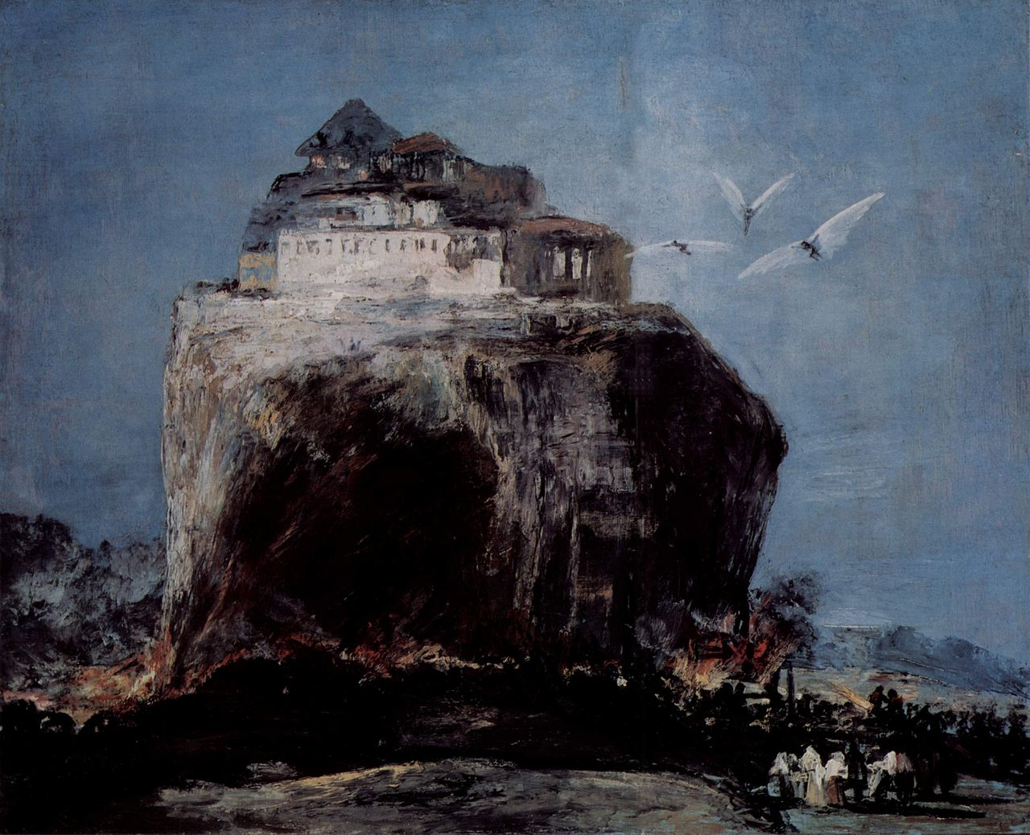
Forgery: civil and criminal issues
Is there an issue? Is the work:
  Misattributed?
    School of…
    Follower of…
  A forgery?
  A copy or homage?
  A pastiche?

Slide 4
Forgery: civil and criminal issues
Christie’s | Sotheby’s | Bonhams
5 year authenticity guarantee | 5 year authenticity guarantee | No 5 year authenticity guarantee
No definition of forgery or counterfeit | Counterfeit defined: A lot that in Sotheby’s reasonable opinion is an imitation created to deceive as to authorship, origin, date, age, period, culture or source, where the correct description of such matters is not reflected by the description in the catalogue | Forgery defined: An imitation intended by the maker or any other person to deceive as to authorship, attribution, origin, authenticity, style, date, age, period, provenance, culture, source or composition, which at the date of the Sale had a value materially less than it would have had if the Lot had not been such an imitation, and which is not stated to be such an imitation in any description of the Lot.

Slide 5
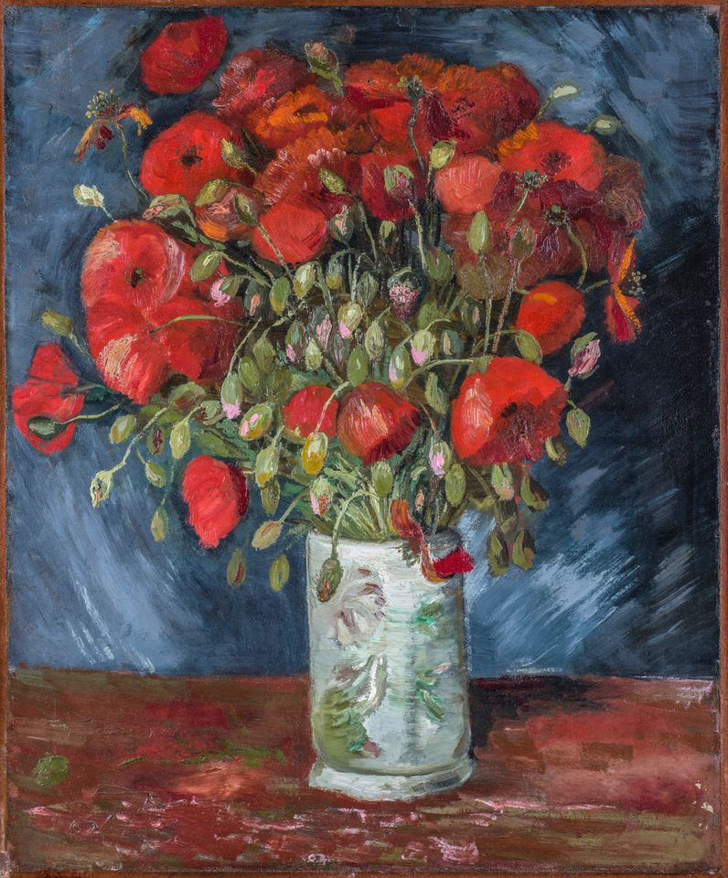
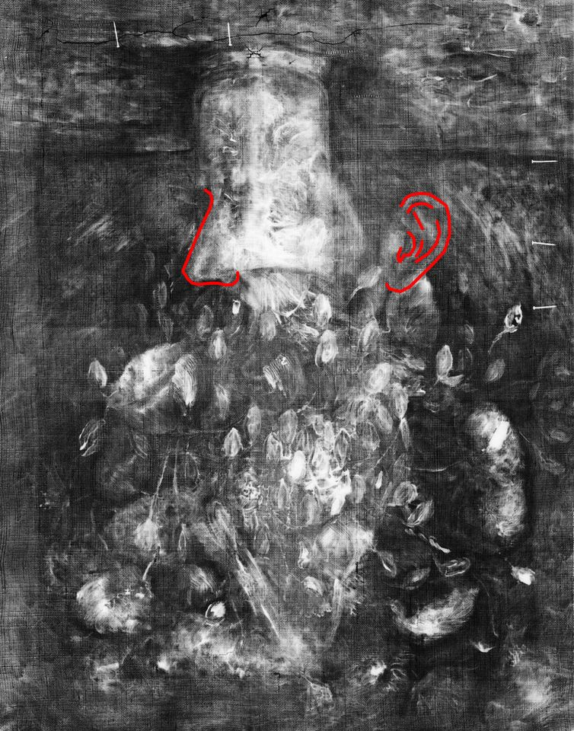
VAN GOGH - 2019
Following an examination of the canvas, ground layer, pigments and style, as well as stylistic and art historical research, the Van Gogh Museum in Amsterdam recently confirmed a hidden image of a portrait beneath the surface, which has been authenticated as a Van Gogh.

Slide 6
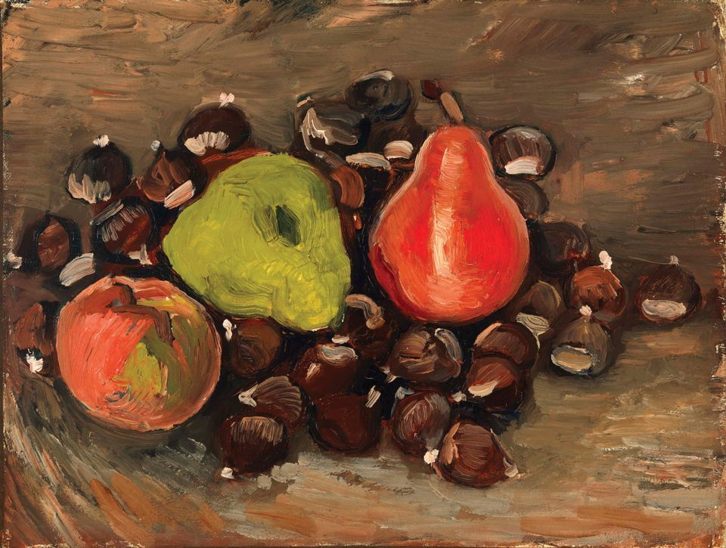
Van gogh - 2019
A still life painting at the Fine Arts Museums of San Francisco was previously dismissed by many experts as a fake Van Gogh
The painting has recently been accepted by experts as an authentic Van Gogh
The Van Gogh Museum have dated the painting to the autumn of 1886.

Slide 7
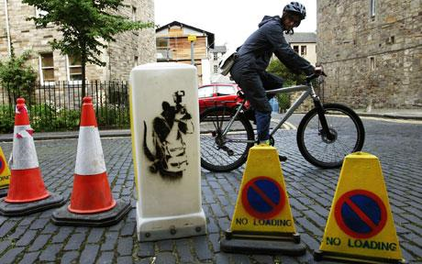
BANKSY

Slide 8
Forgery: civil and criminal issues
Civil
Breach of contract – authenticity warranties
Misrepresentation – innocent & fraudulent
Implied terms under the Sale of Goods Act 1979 – description and quality
Criminal
Forgery and Counterfeiting Act 1981 – false instrument with intent
Fraud Act 2006
Proceeds of Crime Act 2002
Conspiracy to Defraud – Common law offence – forgery rings

Slide 9

Forgery: civil and criminal issues
Myatt and Drewe
Over 200 Impressionist and Cubist works forged using emulsion paint rather than oil, and forged provenance

Slide 10
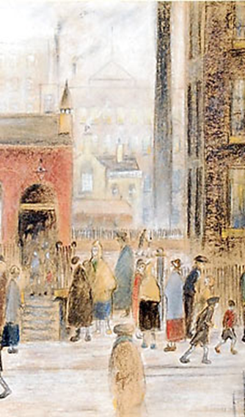
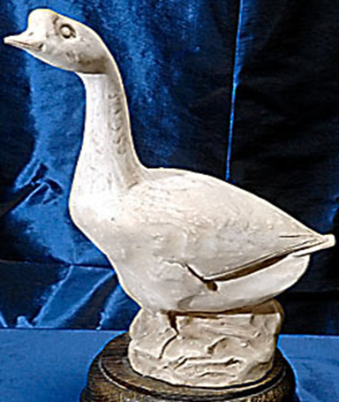
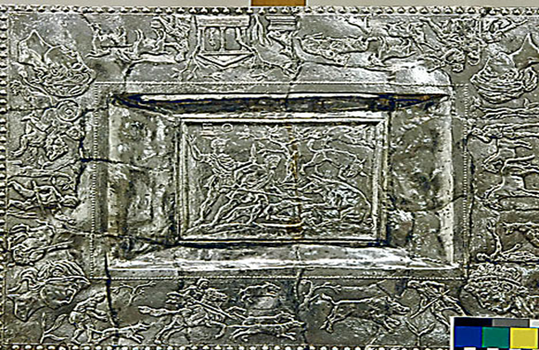
THE ARTFUL CODGERS

Slide 11
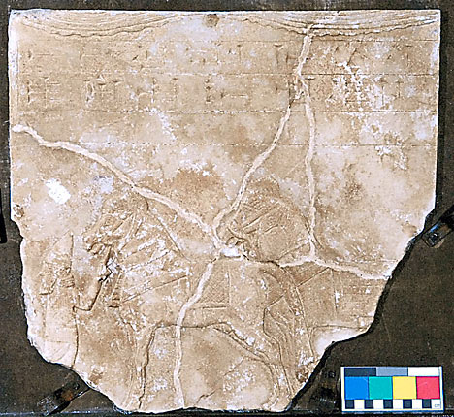
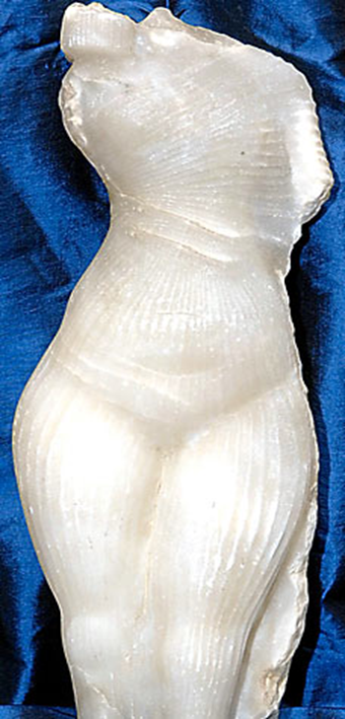
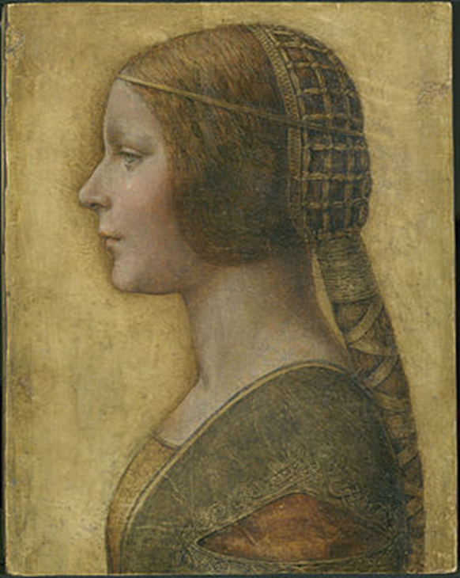
The artful codgers

Slide 12

SPEAKER
Amanda Gray
Managing Associate
amanda.gray@mishcon.com
T: +44 20 3321 6745

